Slide 1
Logistic Regression

Slide 2
Introduction to Logistic regression
A basic machine learning approach that is frequently used for binary classification tasks is called logistic regression.
Though its name suggests otherwise, it uses the sigmoid function to simulate the likelihood of an instance falling into a specific class, producing values between 0 and 1.
Logistic regression, with its emphasis on interpretability, simplicity, and efficient computation, is widely applied in a variety of fields, such as marketing, finance, and healthcare, and it offers insightful forecasts and useful information for decision-making.
Notes:
https://medium.com/intro-to-artificial-intelligence/logistic-regression-using-gradient-descent-bf8cbe749ceb

Slide 3
About Binary classification with logistic regression
A statistical model for binary classification is called logistic regression. Using the sigmoid function, it forecasts the likelihood that an instance will belong to a particular class, guaranteeing results between 0 and 1.
To minimize the log loss, the model computes a linear combination of input characteristics, transforms it using the sigmoid, and then optimizes its coefficients using methods like gradient descent.
These coefficients establish the decision boundary that divides the classes. Because of its ease of use, interpretability, and versatility across multiple domains, Logistic Regression is widely used in machine learning for problems that involve binary outcomes.
Overfitting can be avoided by implementing regularization.

Slide 4
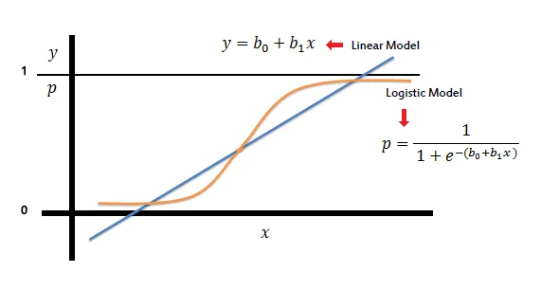

Slide 5
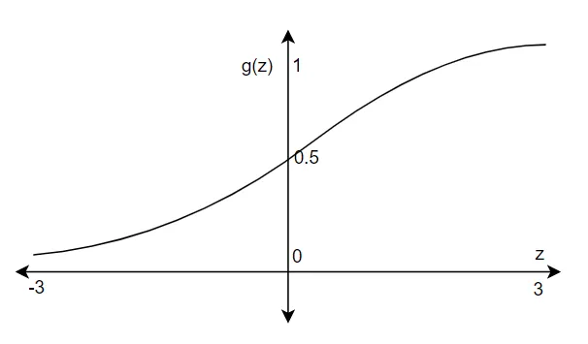
Sigmoid Function
Sigmoid Function: The main function that ensures outputs are between 0 and 1 by converting a linear combination of input data into probabilities.
The sigmoid function is denoted as
σ(z) σ(z), and is defined as:
Where, z is linear combination of input features and coefficients.

Slide 6
Hypothesis Function: uses the sigmoid function and weights (coefficients) to combine input features to estimate the likelihood of falling into a particular class.
In logistic regression, the hypothesis function is provided by:

Slide 7
Key Concepts of Logistic Regression
Sigmoid Function: The main function that ensures outputs are between 0 and 1 by converting a linear combination of input data into probabilities.
The sigmoid function is denoted as
σ(z)
σ(z), and is defined as:
σ(z)=11+ez
σ(z)=
1+e
z
1
​
Where, z is linear combination of input features and coefficients

Slide 8
How the Logistic Regression Algorithm Works

Slide 9
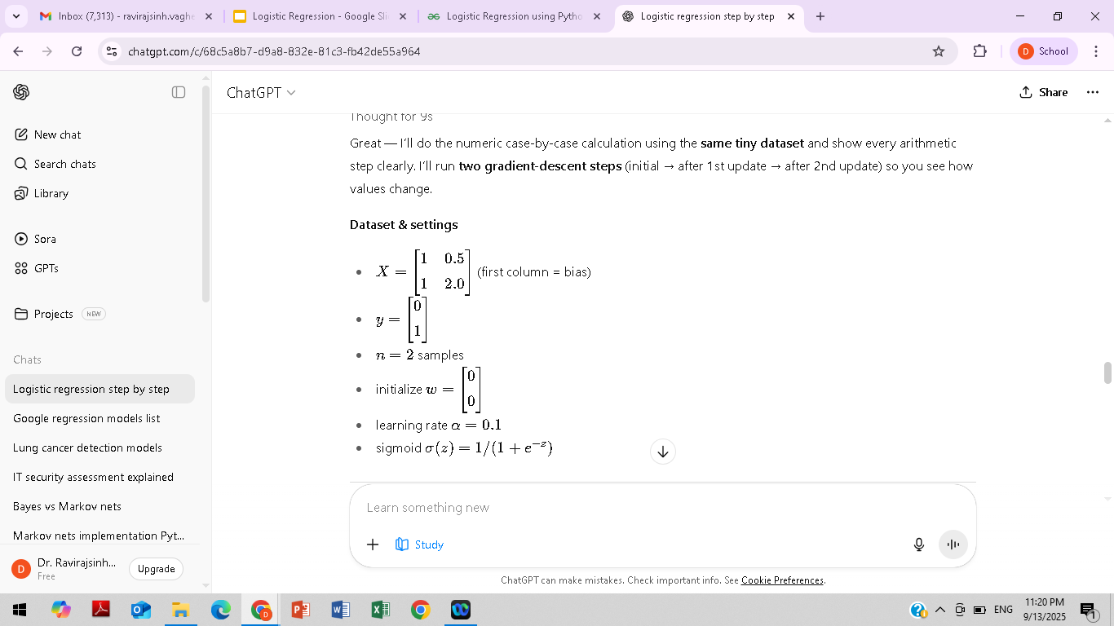
Python code for simple x features and binary classification
from sklearn.linear_model import LogisticRegression
import numpy as np
X_raw = np.array([[0.5], [2.0]]) # features (no bias column — sklearn handles intercept)
y = np.array([0, 1])
model = LogisticRegression(solver='liblinear') # common simple solver
model.fit(X_raw, y)
probs = model.predict_proba(X_raw)[:,1] # predicted probability of class 1
preds = model.predict(X_raw)
print("probs:", probs)
print("preds:", preds)

Slide 10
Step 0 — initial forward pass (with w=[0,0])
Linear scores: z=Xw
z1=1∗0+0.5∗0=0
z2=1∗0+2.0∗0=
So z=[0,0]

Slide 11
Probabilities pi=σ(zi)
σ(0)=1/(1+e0) =1/2=0.5
So p=[0.5, 0.5]p=[0.5,\,0.5]p=[0.5,0.5]
Log Loss: The optimization cost function is a measure of the discrepancy between actual class labels and projected probability.
The definition of the log loss for a single instance is:

Slide 12
Cost function
We need to find appropriate w and b in such a way that we can fit a straight line that is going to be an approximate representation of the data points.
In order to identify the best w and b, we need to define the cost function, J(w,b). The cost function gives how good is the model with a specific value of w and b.
As the sigmoid function is a non-convex function, we need to derive a cost function which make this algorithm makes convex.
Thus, we can apply the gradient descent algorithm to find the best fit value for w and b.

Slide 13
Loss per sample (binary cross-entropy):
ℓi​=−(yi​logpi​+(1−yi​)log(1−pi​)).
For sample1 (y1=0): ℓ1=−(0⋅log⁡0.5+1⋅log⁡(1−0.5))=−log⁡(0.5)=0.69314718056
For sample2 (y2=1): ℓ2=−(1⋅log⁡0.5+0⋅log⁡(0.5))=−log⁡(0.5)=0.69314718056
Average loss J=(0.693147+0.693147)/2=0.69314718056J

Slide 14
In order to find the best w and b, we utilize the gradient descent algorithm. Gradient descent and its variants are widely used in machine learning

Slide 15
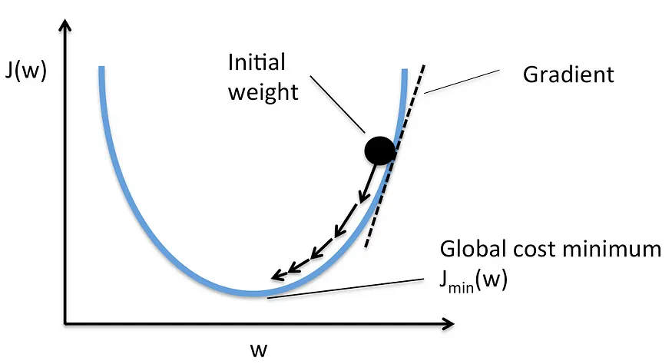
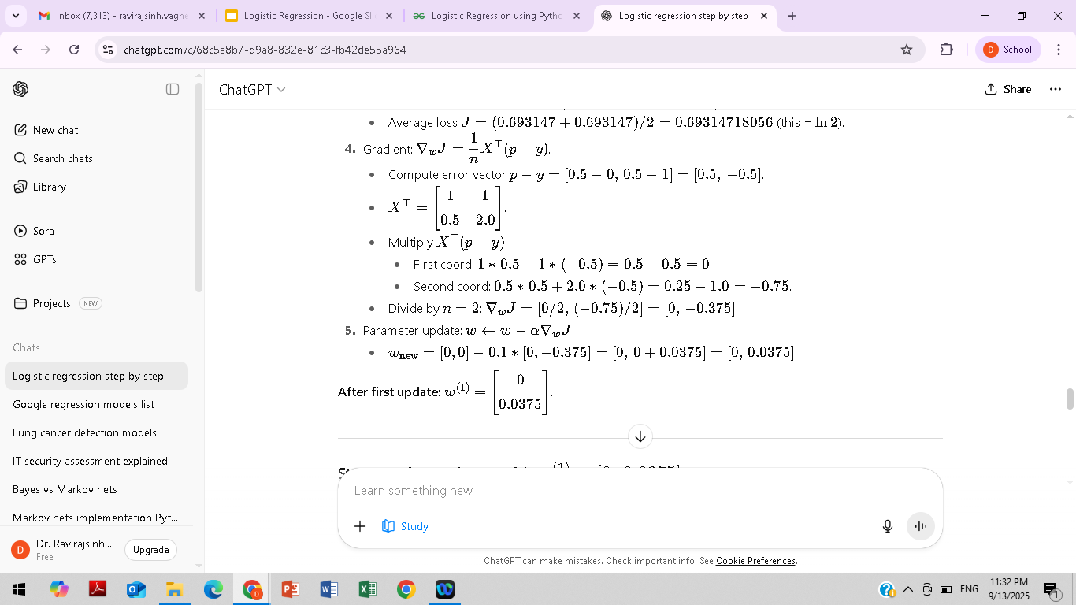

Slide 16
The gradient descent algorithm is a first-order iterative optimisation to find out the minimum value in the cost function.
In this approach, we initialise w(weights) with a random value and find out the gradient.
Then we update the w in the opposite direction of the gradient. And, this process continues until the cost minimum is found.
The gradient always points towards the direction of the greatest increase, so in order to find the minimum or descent point, we update the weights in the opposite direction of the gradient.
We apply the same approach to find the minimum of b as well.

Slide 17


Slide 18
Decision Boundary: The surface or line used to divide instances into several classes according to the determined probability.
Probability Threshold: a number (usually 0.5) that is used to calculate the class assignment using the probabilities that are anticipated.
Odds Ratio: The likelihood that an event will occur as opposed to not, which sheds light on how characteristics and the target variable are related.

Slide 19
High-dimensional Logistic Regression
Using L1 (Lasso) or L2 (Ridge) regularization to handle thousands of features (like gene expression data).
Ongoing research explores efficient optimization for ultra-high dimensional data.
Sparse Logistic Regression
Feature selection built into logistic regression (important in genomics, text mining, cybersecurity).

Slide 20
Robust & Fair Logistic Regression
Dealing with noisy labels, adversarial examples, or bias/fairness in predictions.
Extensions with Nonlinearities
Kernel Logistic Regression → combines logistic regression with kernel methods to capture nonlinear relationships.
Hybrid Models
Combining logistic regression with deep learning (e.g., last layer of a neural net often acts like logistic regression).
In cybersecurity research, people often embed logistic regression inside ensemble models (stacking with random forests, XGBoost).

Slide 21
Explainable AI (XAI)
Logistic regression is often used as a reference model in interpretability research, since its coefficients have direct meaning (log-od

